Slide 1
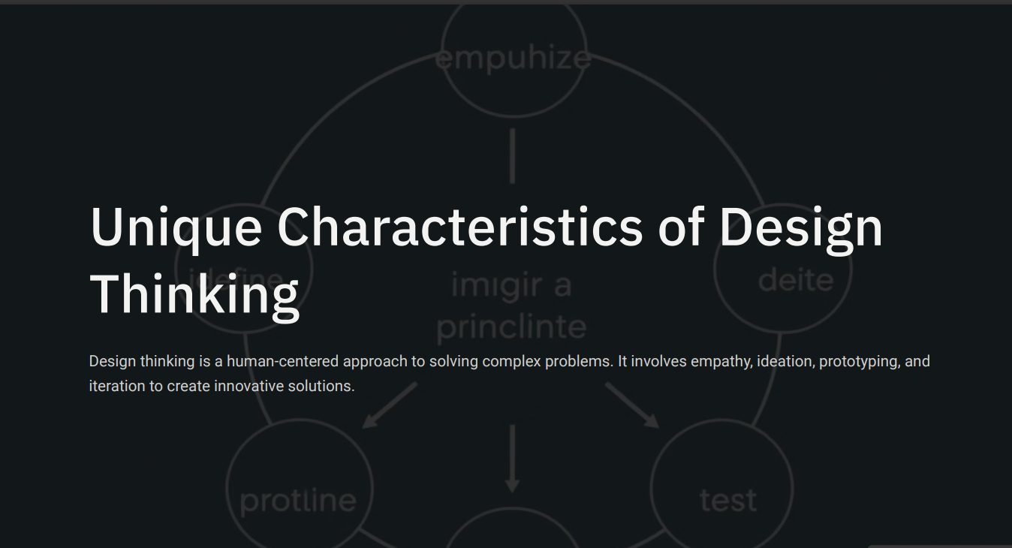
TASK :- 01

Slide 2
Iterative Process
User- Centered Approach
Experimentation and Risk-Taking:
Unique Characteristics of Design Thinking of smart phones
Collaboration and Cross-Disciplinary Teams
Problem Reframing

Slide 3


